Slide 1
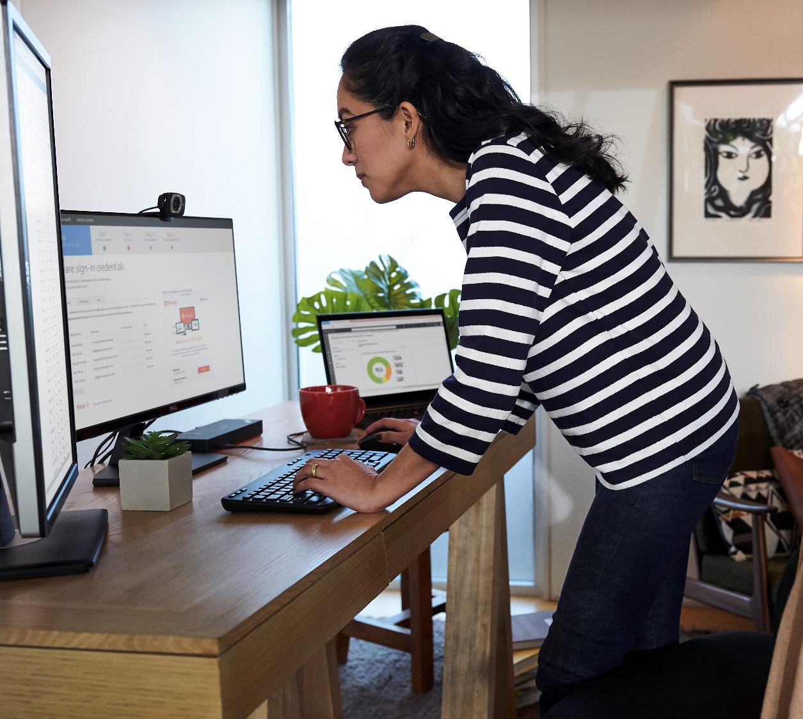
Guide to Secure Remote Work
https://aka.ms/remoteworkperth

Slide 2
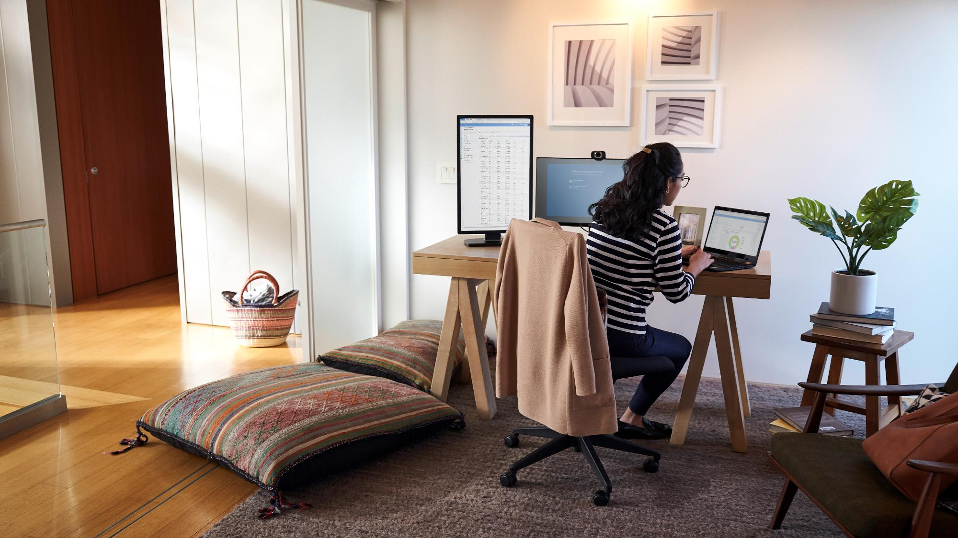

Agenda
Welcome
Guide
WVD User View Demo
Tips and tricks for remote work
Q&A

Slide 3


Local Response Team
For any questions or assistance, please contact one of your local team members who can assist:
Charles Poulsen, charles.poulsen@microsoft.com
Wasim Anwar, wasim.anwar@microsoft.com
Russel Anderson, russela@microsoft.com
Brian Carter, brian.carter@microsoft.com
Antoinette Jago, anjago@microsoft.com
Jiaranai Keatnuxsuo, jiaranai.keatnuxsuo@microsoft.com
Jonathan Wade, jowade@microsoft.com
Zane Rahui, zarahui@microsoft.com

Slide 4
Resources Repository
As the COVID-19 situation unfolds around the world, Microsoft is providing updates, guidance and support via:
Our Microsoft global hub found here. https://news.microsoft.com/covid-19-response/
Our Microsoft Australia Hub here: https://www.microsoft.com/en-au/coronavirus
Additionally, we will be updating this document and other localised and curated WA content here: https://aka.ms/RemoteWorkPerth/

Slide 5
Staged Approach
Phase 1 - Focused on Business Continuity
Collaboration, meetings, communication and coordination
Secure Remote Access to Desktops and Applications using Windows Virtual Desktop
Phase 2 - Expanding to the following scenarios, by priority:
Crisis Management
Crisis Communications: Response Command Centre and Support Agencies (Inbound/Inter Agency/Outbound)
Remote Customer Engagement & Service Delivery

Slide 6
IT Admin Resources
Deployment Assistance from FastTrack
Teams and Modern Workplace
The top 9 ways Microsoft is enabling remote work for its employees
Top 5 Ways Azure Active Directory can help you enable remote work, securely
CISO security guidance for remote working
Windows Virtual Desktop
Deployment of WVD
Connecting to WVD via Web, Android, iOS, Mac or PC Technical FAQ
Example cost for WVD compute is between $5-$10 Per User Per Month (Light -> Heavy user)

Slide 7
End User Resources
Teams end-user training materials:
Microsoft Office and Teams training center
Teams guides
Microsoft Teams training on YouTube Playlist
Windows Virtual Desktop
User Connection How To Guide
App available in App Stores (Android, Apple, Windows)
Through a web browser at https://rdweb.wvd.microsoft.com/webclient/index.html, using their existing Work or School account.

Slide 8
Additional Resources/Info
Microsoft 365 E3 or A3 license - Remote workers can use Teams, Office Pro Plus, or Azure Active Directory App Proxy.
Microsoft 365 E3 or A3 license - Windows 10 Ent. & Windows 7 Ent. desktops and apps thru WVD
WVD does incur charges for the storage and compute
Free 6-month Office 365 E1 offer
WVD Deployment Helpdesk
WVD Funding for partner assisted deployment (Limited Availability and Subject to Approval)

Slide 9
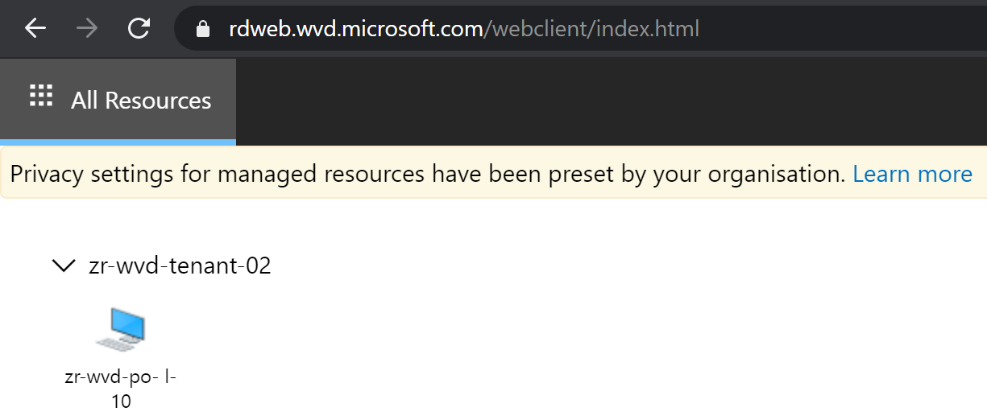
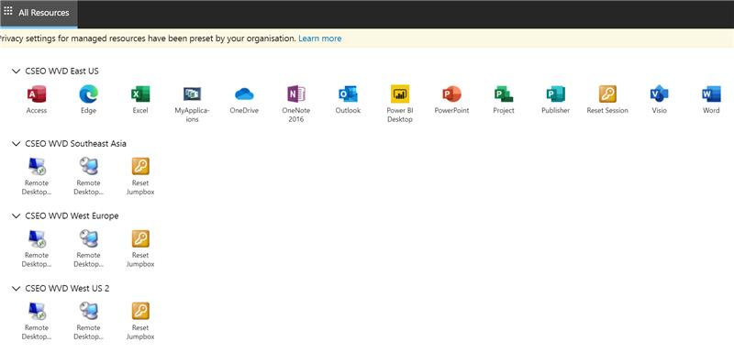
Windows Virtual Desktop Demo

Slide 10
Microsoft Webinar recording – Remote Working
Best practices on working remotely https://microsoftteams.eventbuilder.com/event/15502/recording
Technology
Personal Behaviour
Team Culture

Slide 11
Communicate Often
Your rhythm with online work from home might look different than it does in the office. For example, you may be balancing work and childcare at the same time. Communicate your schedule to your coworkers so that they know when to reach out to you.
Set Expectations as a Team
Change Status, Status Message
Set Automatic Replies in Outlook
Mark a Message as Important or Urgent
Notes:
Show Users
Change your Status in Teams - https://support.office.com/en-us/article/change-your-status-in-teams-ce36ed14-6bc9-4775-a33e-6629ba4ff78e
Set your Status Message in Teams - https://support.office.com/en-us/article/Set-your-status-message-in-Teams-22e02023-3840-40c7-b701-6676821aeab3
Mark a Message as Urgent in Teams - https://support.office.com/en-us/article/Mark-a-message-as-important-or-urgent-in-Teams-ea99d5b6-1317-4550-8d75-86ff14cd4462

Slide 12
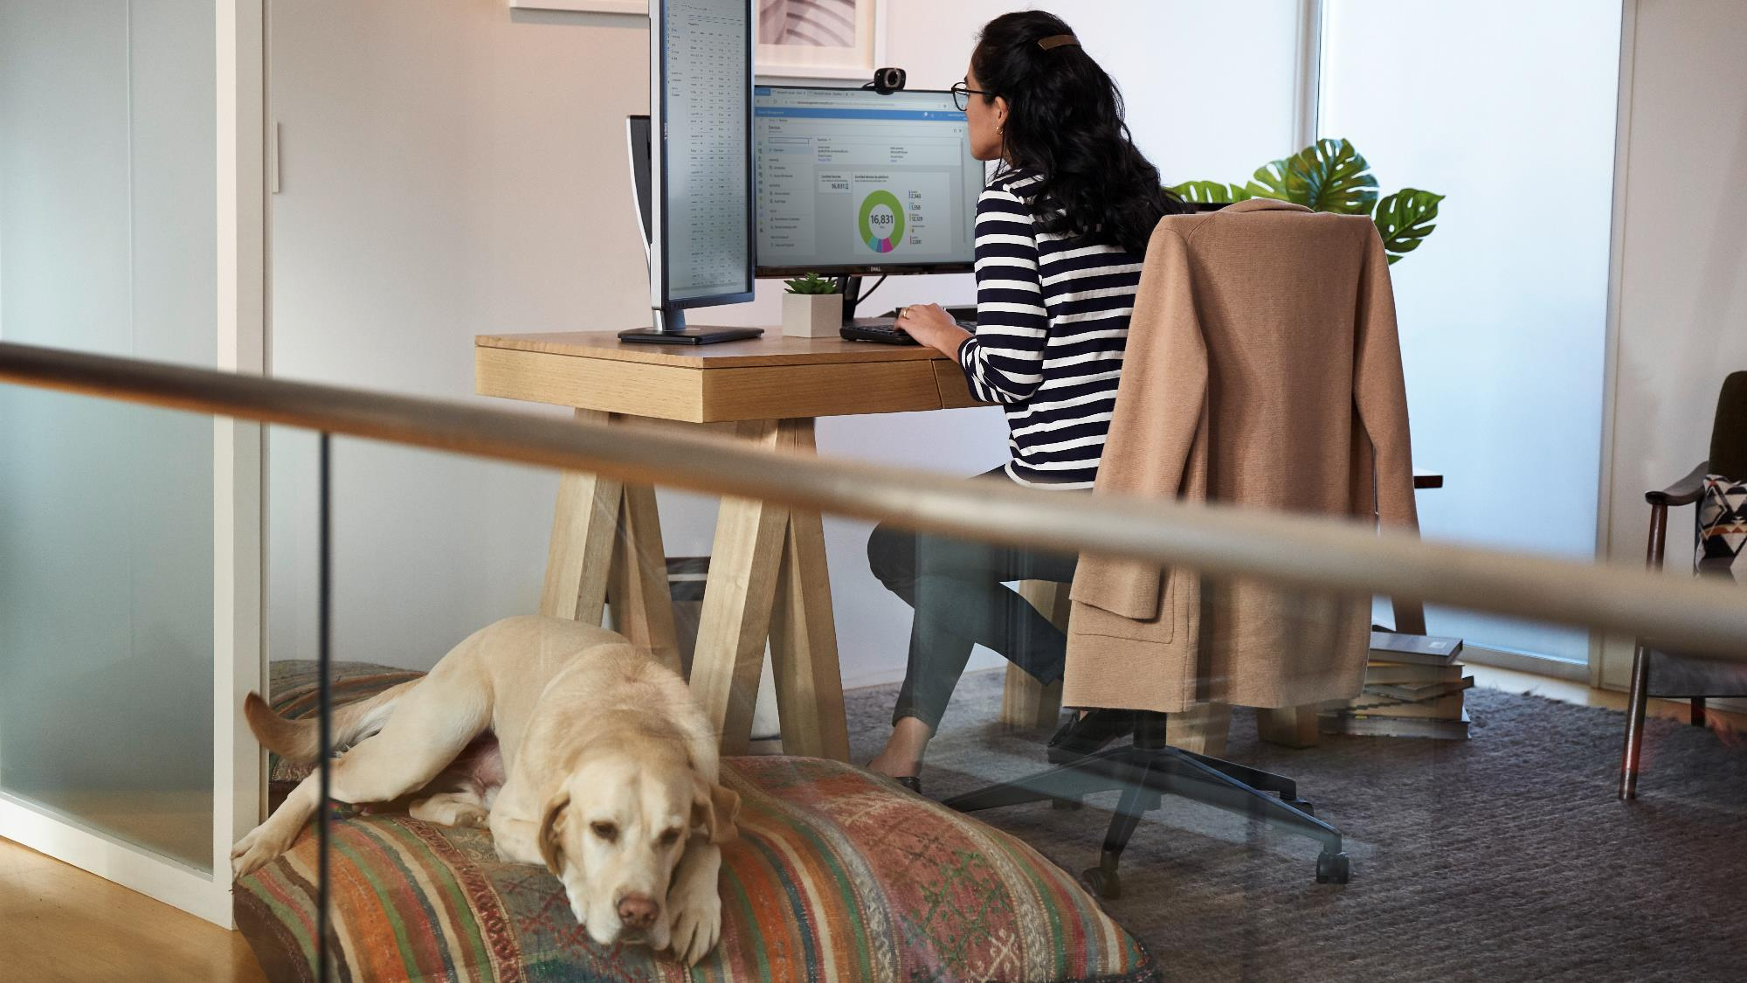

Maintain Healthy Boundaries
Without the normal workday signals, like a commute, it can be harder to unplug. Make sure to take breaks, stay hydrated, and give yourself opportunities to “clock out” from remote work at the end of the day.
Outlook Time Zones
Outlook Setting - Work Hours
Outlook Setting - End Meetings Early
Notes:
Show Users
Add/Remove Change Time Zones in Outlook – https://support.office.com/en-us/article/add-remove-or-change-time-zones-5ab3e10e-5a6c-46af-ab48-156fedf70c04
Set Work Hours in Outlook - https://support.office.com/en-us/article/Learn-more-about-work-hours-in-Outlook-af2fddf9-249e-4710-9c95-5911edfd76f6
End Meetings Early - https://support.office.com/en-us/article/Schedule-a-meeting-with-other-people-5C9877BC-AB91-4A7C-99FB-B0B68D7EA94F

Slide 13


Embrace Online Meetings
Make sure all meetings include a virtual “join” option so that team members can join from wherever they are working. Turn video on so your team can interact face to face and feel more connected.
Schedule a Meeting
Join a Meeting
Share Content
Video
Notes:
Show Users
Schedule a Meeting in Teams - https://support.office.com/en-us/article/Schedule-a-meeting-in-Teams-943507a9-8583-4c58-b5d2-8ec8265e04e5
Join a Meeting in Teams - https://support.office.com/en-us/article/join-a-meeting-in-teams-1613bb53-f3fa-431e-85a9-d6a91e3468c9
Share Content in a Meeting in Teams - https://support.office.com/en-us/article/share-content-in-a-meeting-in-teams-fcc2bf59-aecd-4481-8f99-ce55dd836ce8
Schedule a Teams Meeting from Outlook - https://support.office.com/en-us/article/schedule-a-teams-meeting-from-outlook-883cc15c-580f-441a-92ea-0992c00a9b0f
Quick Start Learning Pathway – Manage Meetings - https://support.office.com/article/join-a-teams-meeting-078e9868-f1aa-4414-8bb9-ee88e9236ee4
For IT Admins
Meetings and Conferencing in Teams - https://docs.microsoft.com/en-us/microsoftteams/deploy-meetings-microsoft-teams-landing-page
Teams Academy Meetings Introduction – Video: https://aka.ms/teams-meetings-intro Deck: https://aka.ms/teams-meetings-intro-deck

Slide 14
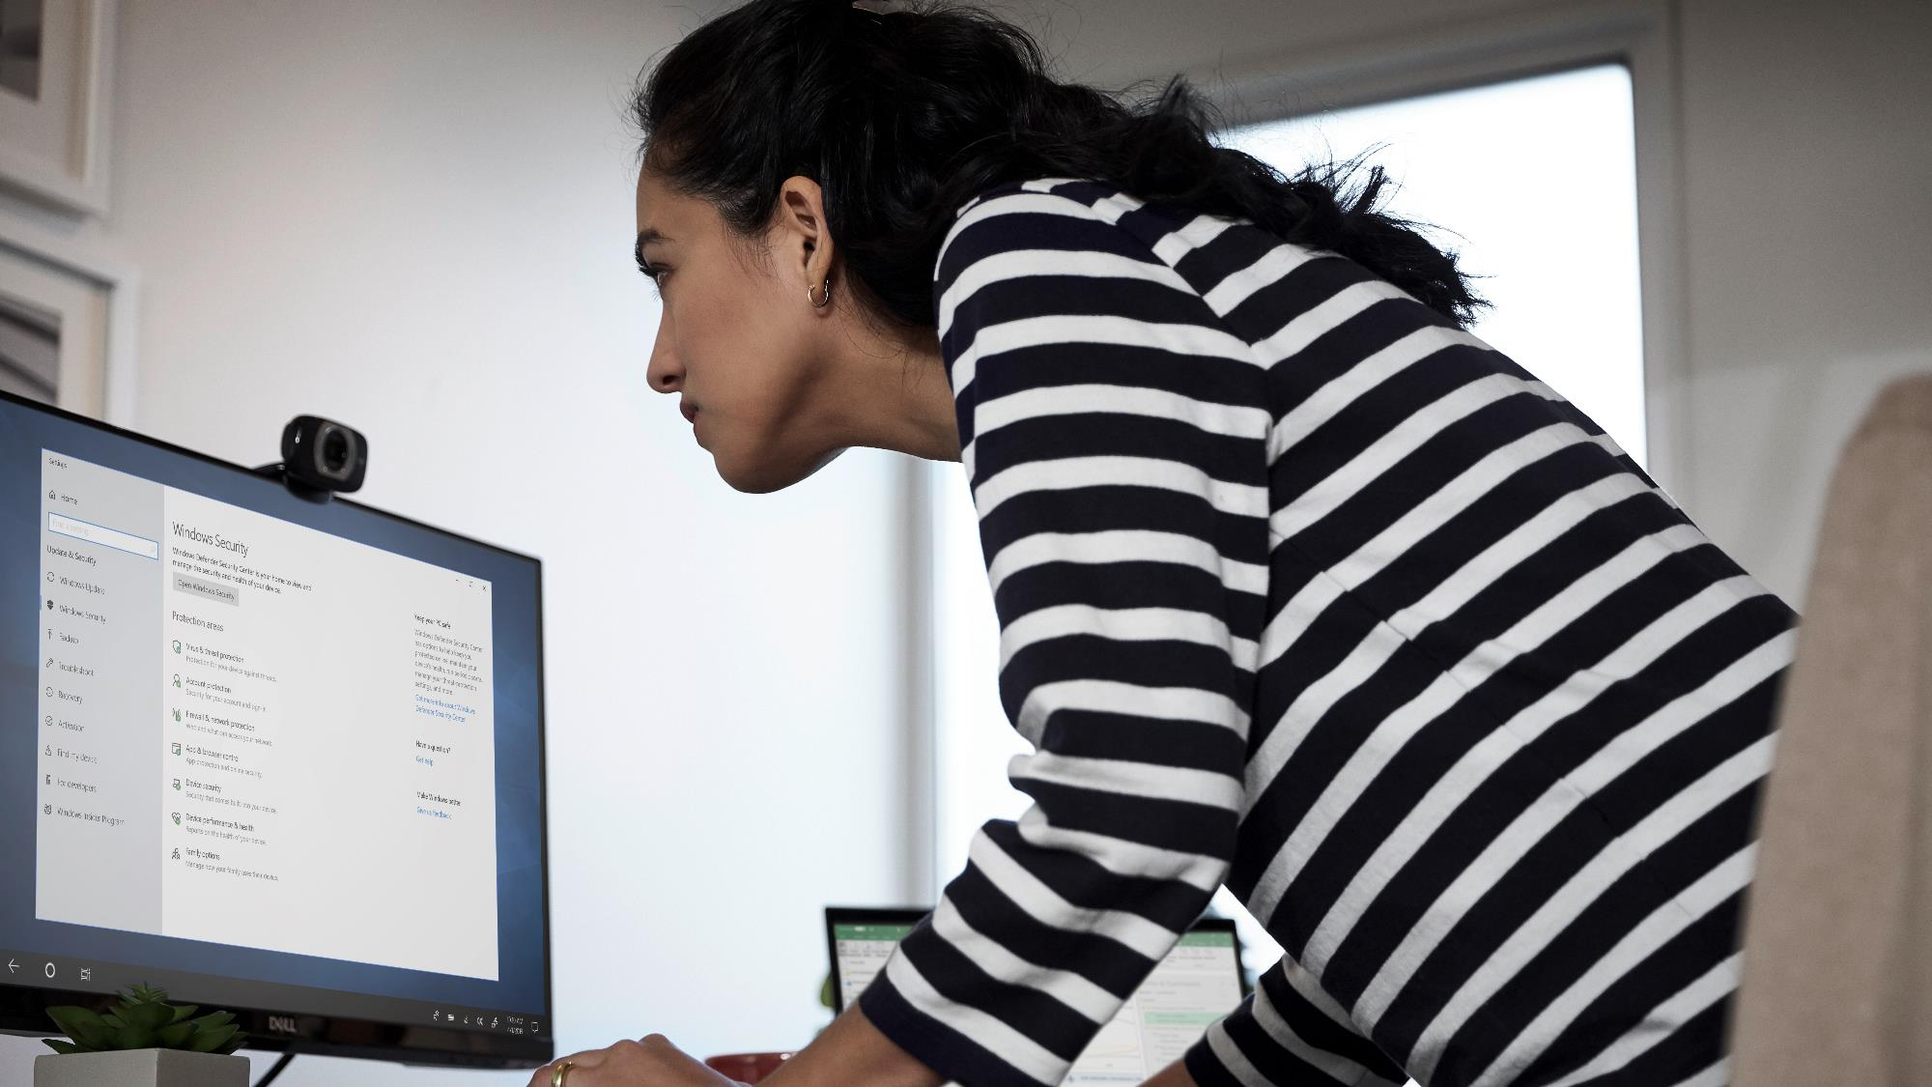

Be mindful and inclusive
A crowded conference call can make it difficult for people to share their opinions. Pause frequently to allow time for questions and remind attendees that they can use the chat window to share their thoughts.
Live Captions
OneNote
Get a Link to Teams, Channels, Tabs, Files, Conversations
Notes:
Use Live Captions in Teams - https://support.office.com/en-us/article/Use-live-captions-in-a-Teams-meeting-4be2d304-f675-4b57-8347-cbd000a21260
Add a OneNote to Teams - https://support.office.com/en-us/article/Add-a-OneNote-notebook-to-Teams-0ec78cc3-ba3b-4279-a88e-aa40af9865c2
Get a Link to a File - https://support.office.com/en-us/article/get-a-link-to-a-file-in-teams-7bd003ce-87e2-4b4e-9f30-b27ef5ea471f
Get a Link to a Tab - https://support.office.com/en-us/article/get-a-link-to-a-tab-in-teams-9348ec0d-7e3e-4396-885c-474241c58849

Slide 15

Record your meetings
When you start a meeting, hit “record.” Team members who aren’t able to join can watch later or search the automatically generated transcript for important information. That way, people can easily review anything they missed or need repeated.
Record a Meeting
Play and Share a Recording
Notes:
Record a Meeting in Teams - https://support.office.com/en-us/article/Record-a-meeting-in-Teams-34dfbe7f-b07d-4a27-b4c6-de62f1348c24
Play and Share a Recording - https://support.office.com/en-us/article/play-and-share-a-meeting-recording-in-teams-7d7e5dc5-9ae4-4b94-8589-27496037e8fa

Slide 16

Make up for missing hallway talk
The quick chat at the water cooler is what many people miss the most when working remotely. Instead, be deliberate about and connecting with your coworkers. Think about chat messages as your virtual watercooler and set yourself a reminder to check in with people regularly.
Start a Chat
Conversations Tab in Channels
Format a Message
Use @Mentions
Notes:
Start a Chat in Teams - https://support.office.com/en-us/article/Start-a-chat-in-Teams-0c71b32b-c050-4930-a887-5afbe742b3d8
Using the Conversation Tab in Teams - https://support.office.com/en-us/article/Using-the-Conversation-tab-in-Microsoft-Teams-53d1c530-3797-4a6f-9892-6760f8763df2
Format a Message in Teams - https://support.office.com/en-us/article/Format-a-message-in-Teams-9f7c64e4-0316-472f-b1e8-430cebcfc1e5
Use @Mentions to Get Attention - https://support.office.com/en-us/article/use-mentions-to-get-someone-s-attention-in-teams-eb4f059d-320e-454e-b111-03361d4d6855

Slide 17

Bring the team together
Working remotely can feel a bit isolating. It’s important to create opportunities for the whole team to virtually get together, whether it’s large brainstorms with the Microsoft Whiteboard app or daily check-ins over a virtual coffee.
Channel Meeting
Notes:
Use Whiteboard in Teams - https://support.office.com/en-us/article/7a6e7218-e9dc-4ccc-89aa-b1a0bb9c31ee
Use Planner in Microsoft Teams - https://support.office.com/en-us/article/use-planner-in-microsoft-teams-62798a9f-e8f7-4722-a700-27dd28a06ee0
Take Meeting Notes in Teams - https://support.office.com/en-us/article/take-meeting-notes-in-teams-3eadf032-0ef8-4d60-9e21-0691d317d103
Add a OneNote Notebook to Teams -https://support.office.com/en-us/article/Add-a-OneNote-notebook-to-Teams-0ec78cc3-ba3b-4279-a88e-aa40af9865c2

Slide 18

Have Fun
Use Teams to encourage fun activities and challenges to maintain morale. Holding a photo contest or praising employees for creative ideas are great ways to help the team stay positive, engaged and energized.
Send Praise
Send an Emoji, GIF or Sticker
Notes:
Send Praise to People - https://support.office.com/en-us/article/Send-Praise-to-people-50f26b47-565f-40fe-8642-5ca2a5ed261e
Send an Emoji, GIF or Stricker - https://support.office.com/en-us/article/send-an-emoji-gif-or-sticker-in-teams-174248c9-e64d-4de1-9f41-3199cc0751ad

Slide 19
Questions?
Check back for updated FAQ and other content here: https://aka.ms/RemoteWorkPerth/

